Slide 1
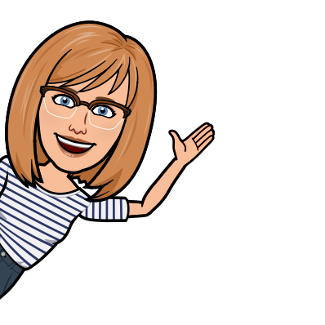
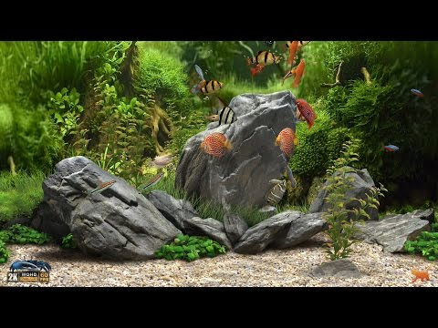
Welcome
to my virtual counseling office! Click on the
objects & explore!

Slide 2
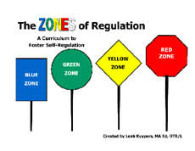
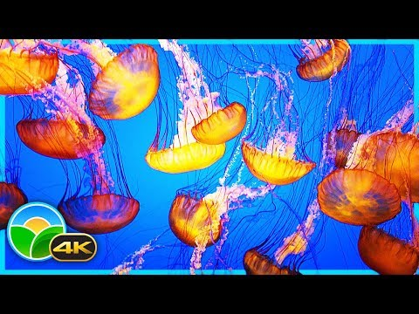
WELCOME
to my Virtual
Counseling Classroom!
Click here for the lesson!

Slide 3
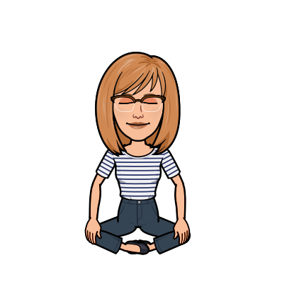
Welcome
to the
Counselor’s Calming Corner
Click on the objects & explore!

Slide 4
A Special Thanks to…
Play slideshow to click on hyperlinks

